Slide 1
Student Registration Portal
Justin Ramirez
The University of Arizona Global Campus
CST499: Capstone for Computer Software Technology
Prof Charmelia Butler
Oct 23, 2023

Slide 2
Contents – Student Registration Portal Presentation
Summarize the information in our SRS document
Review UML Designs
Showcase the website’s landing, login, and enrollment pages
Review MySQL databases
Showcase class registration
PHP Code Review

Slide 3
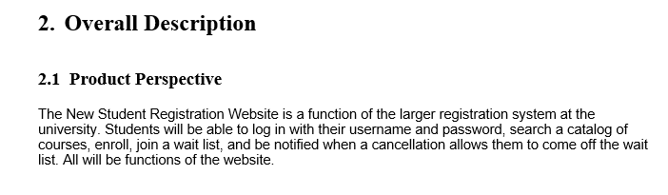
Software Requirement Specifications
The Software Requirements Specifications (SRS) is our formal document which captures the requirements of the software specifications

Slide 4
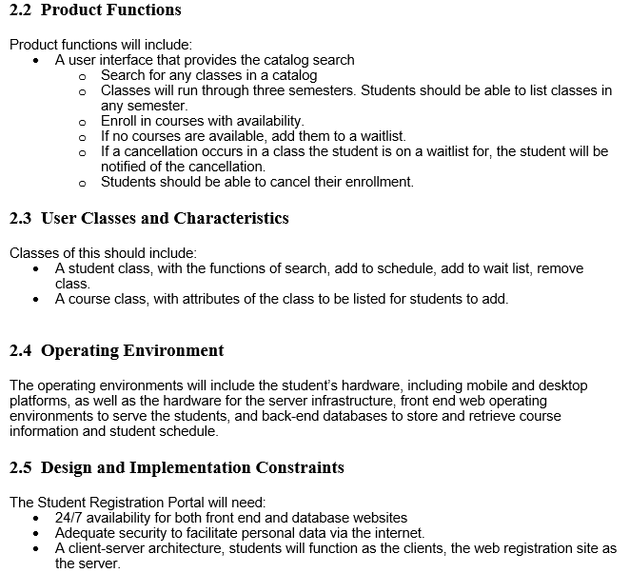
Software Requirement Specifications Cont. Product Specifications

Slide 5
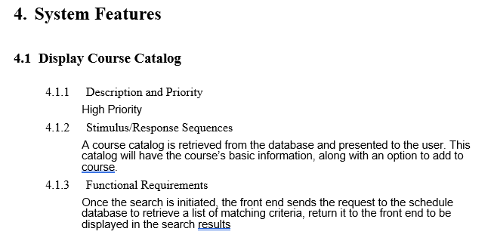
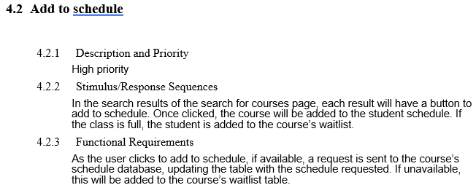
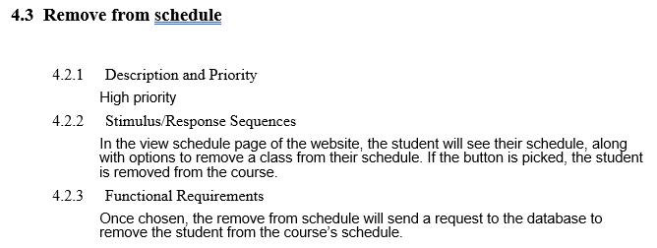
Software Requirement Specifications Cont. Feature Specifications

Slide 6
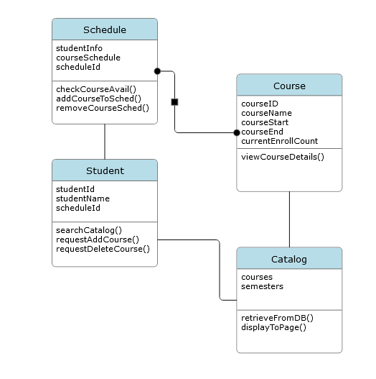
Unified Modeling Language
The UML Diagrams are a standardized, visual depiction of the functional requirements of the software.
Notes:
UML Diagrams simplify the requirements and make them easier for consumption by developers, stakeholders, and management alike.

Slide 7
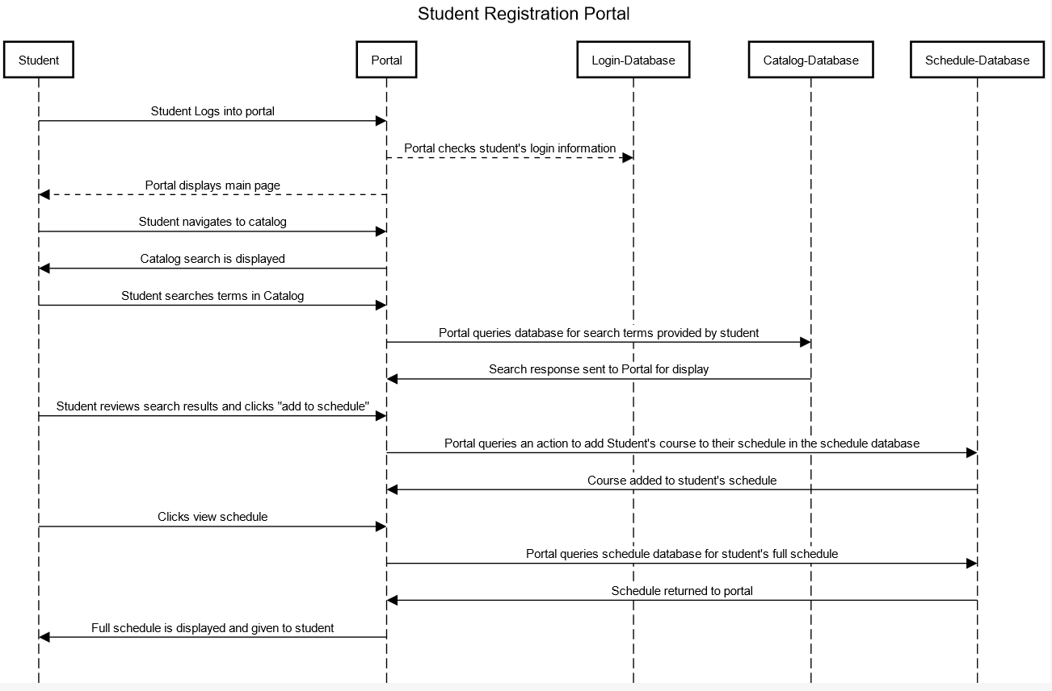
UML Diagrams Cont.
Notes:
Sequence Diagram

Slide 8
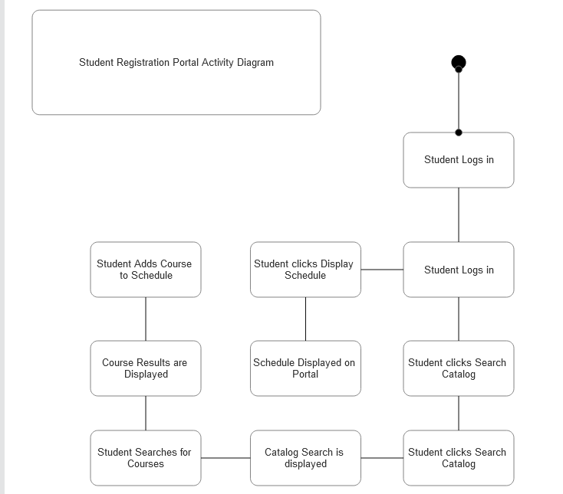
UML Diagrams Cont.
Notes:
Sequence Activity. This diagram shows a sequence of events from beginning to end, with branching paths as decisions are made

Slide 9
Student Registration Portal Demo
The website was designed with a home page that displays a menu with the options a user initially sees – Login and Register
The user can use the Register option to create a new account, and a login page to enter the portal
Two options for logged in users – View Catalog and View Schedule
View Catalog displays the entire catalog and allows for addition of courses; View schedule shows the entire schedule the student has assigned.
This will be a live demo, please stand by while we pull the page into view

Slide 10
Database Overview
We created a MySQL database with three tables for this assignment.
tblcourse contains the course catalog, populated by administrators
tblstudent contains the student database, populated when a new student registers
tblstudentschedule is a reference that links a studentId in tblstudent to a course that student registered in, using coursed in tblcourse

Slide 11
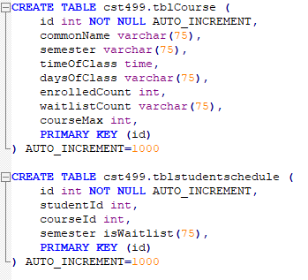
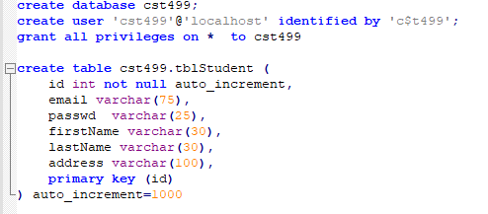
Database Creation

Slide 12
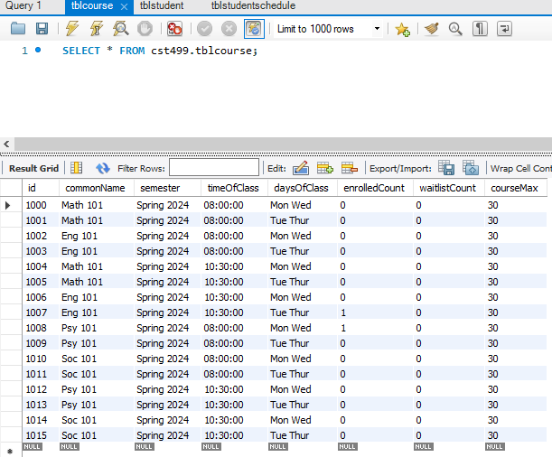
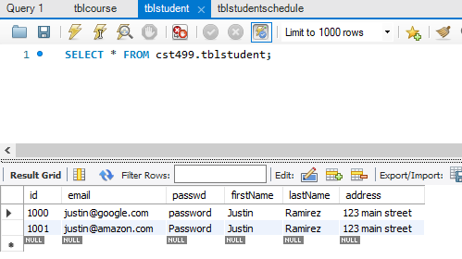
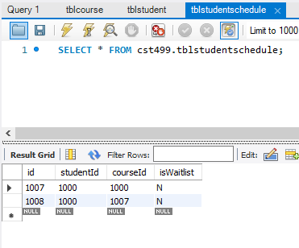
Database Content

Slide 13
PHP Code Review
Each viewable page was created in a separate PHP file. If the page has any interaction, a form was created to submit super global variables to another PHP page that would run a database query.
A separate SQL class was created to simplify SQL queries through a standardized method. Each PHP page with a SQL query includes the SQL.php class

Slide 14
References
Tsui, F., Karam, O., & Bernal, B. (n.d.). Essentials of Software Engineering. Retrieved from https://platform.virdocs.com/read/2348054/11/#/4/2[ch06]/2/2,/3:0,/3:0
Spillner, A, Linz, T & Schaefer, H (2011) Software Testing Foundations, 4th Edition. Retrieved from https://platform.virdocs.com/read/567697/1/#/4/4
javatpoint (nd) Software Requirement Specifications https://www.javatpoint.com/software-requirement-specifications
visual-paradign (nd) What is Unified Modeling Language (UML)? https://www.visual-paradigm.com/guide/uml-unified-modeling-language/what-is-uml/

